Slide 1
SEMINAR LOG PERIODIC ANTENNA
Radiation and antenna theory
Ritu Ann Roy George
B170106ec
S7 ece B Batch

Slide 2
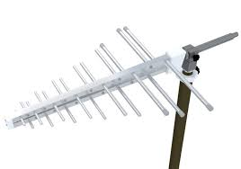
Introduction
In telecommunications, a log-periodic antenna is a wideband, directional antenna, invented by John Dunleavy in 1952.
Types of log period antenna
Zig zag log periodic array
Trapezoidal log periodic
Slot log periodic
Log periodic dipole array, LPDA
The type that is most widely used is the log periodic dipole array, LPDA. The LPDA consists of a number of half-wave dipole driven elements of gradually increasing length, each consisting of a pair of metal rods. The dipoles are mounted close together in a line, connected in parallel to the feedline with alternating phase. Electrically, it simulates a series of two or three-element Yagi antennas connected together, each set tuned to a different frequency.

Slide 3
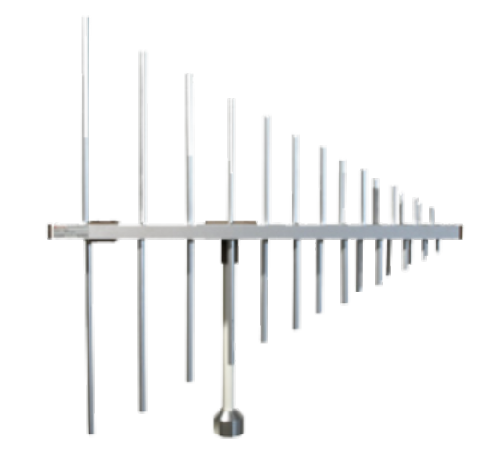
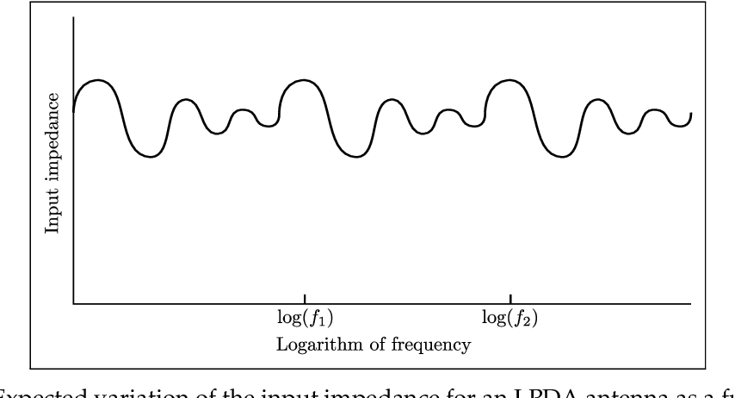
Why the name Log periodic?
The length and spacing of the elements of a log-periodic antenna increase logarithmically from one end to the other.
The variation of input impedance as a function of logarithm of the excitation frequency is periodic in nature.
The alternating elements are driven with 180° (π radians) of phase shift from one another. This is normally done by connecting individual elements to alternating wires of a balanced transmission line.

Slide 4
Working Principle
When the signal meets the first elements on the antenna (i.e. those closest to the front that are the smallest) it will be found that they are spaced close together in terms of the operating wavelength. As the feeder sense is reversed between elements, the fields from these elements will tend to cancel out and no radiation will occur from these elements.
As the RF signal travels along the feeder in the antenna it reaches a point where the feeder reversal and the distance between the elements gives a total phase shift of about 360°. The signal from adjacent dipoles is in phase. The region in which this occurs is called the active region of the log periodic antenna.
Behind the active region, the signal again falls out of phase and no radiation occurs.
The elements outside the active region receive little direct power. Despite this it is found that the larger elements are resonant above the operational frequency and are capacitive. Those in front resonate below the operational frequency and appear inductive.

Slide 5
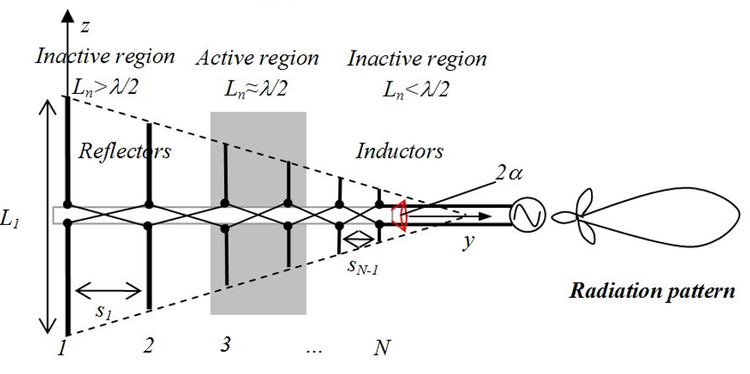
Working principle (contd.)
Accordingly the element immediately behind the active region acts as a reflector and those in front act as directors. This means that the direction of maximum radiation is towards the feed point.
This antenna is often characterized by active and passive regions. It can be seen that the elements near the half-wavelength dipole contribute to LPDA radiation.

Slide 6
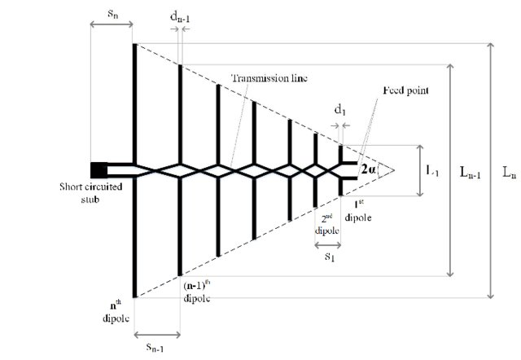

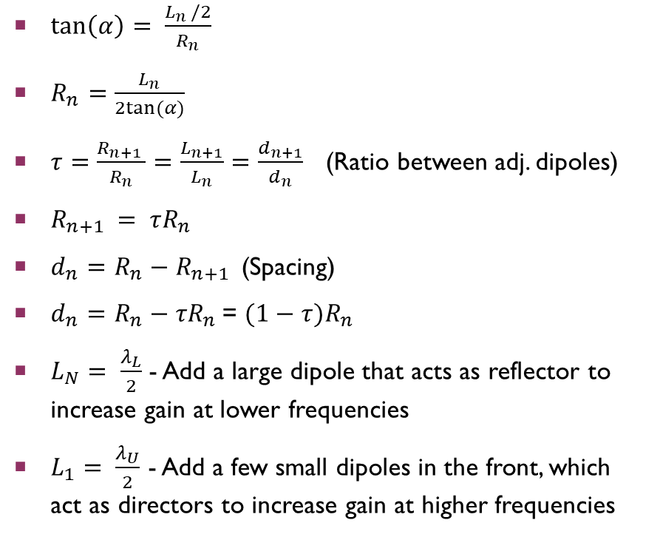
Mathematical relationships
$\tan\left(α\right)= \frac{L_{n }/2}{R_{n}}$
$R_{n}=\frac{L_{n}}{2tan⁡(α)}$
$τ=\frac{R_{n+1 }}{R_{n}}=\frac{L_{n+1}}{L_{n}}=\frac{d_{n+1}}{d_{n}}$ (Ratio between adj. dipoles)
$R_{n+1 }= τR_{n }$
$d_{n}=R_{n}−R_{n+1 }$ (Spacing)
$d_{n}=R_{n}−τR_{n }$= $(1−τ)R_{n }$
$L_{N}= \frac{λ_{L}}{2}$ - Add a large dipole that acts as reflector to increase gain at lower frequencies
$L_{1}= \frac{λ_{U}}{2}$ - Add a few small dipoles in the front, which act as directors to increase gain at higher frequencies
$σ=\frac{ⅆ_{n}}{2L_{n}}$ = $\frac{(1−τ)}{4tan⁡(α)}$ (Scaling Factor)
Thus $α=\tan^{−1}{\frac{(1−τ)}{4σ}\text{.}}$Hence if $α$ is small, then $τ$ is large, which means the dipoles will be close together, and vice versa.

Slide 7
Features of Log periodic Antennas
Advantages
Disadvantages
Compactness of the design can be varied according to the requirements.
Wide frequency response.
High bandwidth and moderate directivity.
Nearly frequency independent in operation.
Installation cost is high.
Less directivity than other antennas like Yagi-uda.
Lower gain on low frequencies (HF, VHF) , compared to Yagi-Uda having the same size.
Not used for omni-directional applications.

Slide 8
Applications
HF communications: Log periodic antenna arrays are often used for diplomatic traffic on the HF bands. A single log periodic antenna will give access to a sufficient number of frequencies over the HF bands to enable communications to be made despite the variations in the ionosphere changing optimum working frequencies.
EMC measurements: EMC is a key issue for all electronic products. Testing requires frequency scans to be undertaken over wide bands of frequencies. When testing for radiated emissions an antenna that is able to provide a flat response over a wide band of frequencies is needed. The log periodic is able to offer the performance required and is widely used in this form of application.
UHF Terrestrial TV: The log periodic antenna is sometimes used for UHF terrestrial television reception. As television channels may be located over a wide portion of the UHF spectrum, the log periodic enables a sufficient bandwidth to be covered (television bands of roughly 54–88 and 174–216 MHz in the VHF and 470–890 MHz in the UHF) while also having high gain for adequate fringe reception.

Slide 9
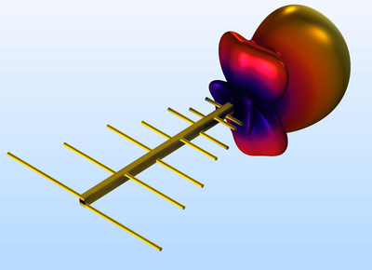
conclusion
Although it has larger size and lower gain than some other antennae models, Log Periodic Antennae are utilized for their good frequency response over a wide band of frequencies.
Situations where directivity and a wide bandwidth are needed make this form of RF antenna design an ideal application.

